Slide 1
Asset pricing
Presented by Hoang Ngan

Slide 2
Agenda
Foundations of Asset Pricing
Machine learning models

Slide 3
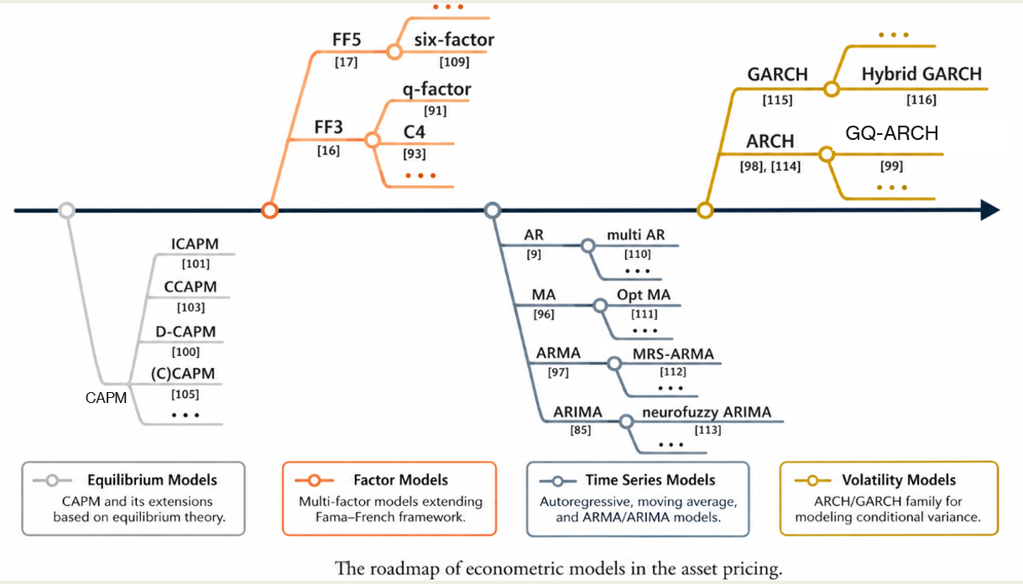
FOUNDATIONs

Slide 4

Capital asset pricing model (capm)
Goal
Show the relationship between systematic risk for an investment and the expected return on it.
Goal is to see if an investment is valued fair by comparing risk and time value to the expected return

Slide 5
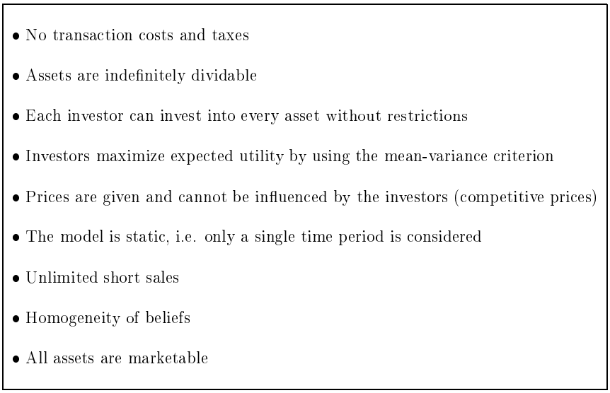
ASSUMPTIONS OF THE CAPM

Slide 6
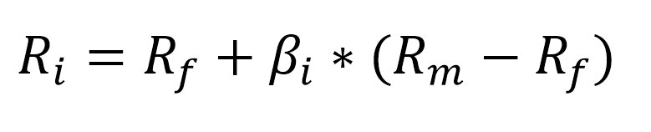
Formula
R_{i} is the expected return on the investment;
R_{f} is the risk-free rate;
β_{i} is the beta of the investment; and
R_{m} is the expected return of the market.

Slide 7

FAMA-FRENCH
(THREE FACTORS)
IDEA
Value stocks and small-cap stocks tend to outperform.
The Three-Factor Model includes these effects, so it explains returns better.
As a result, CAPM may underestimate the performance of portfolios tilted toward value or small-cap stocks.
FACTORS
The size of firms => small minus big (SMB)
Book-to-market values => high minus low (HML)
Excess return on the market => the portfolio's return minus the risk-free rate of return

Slide 8
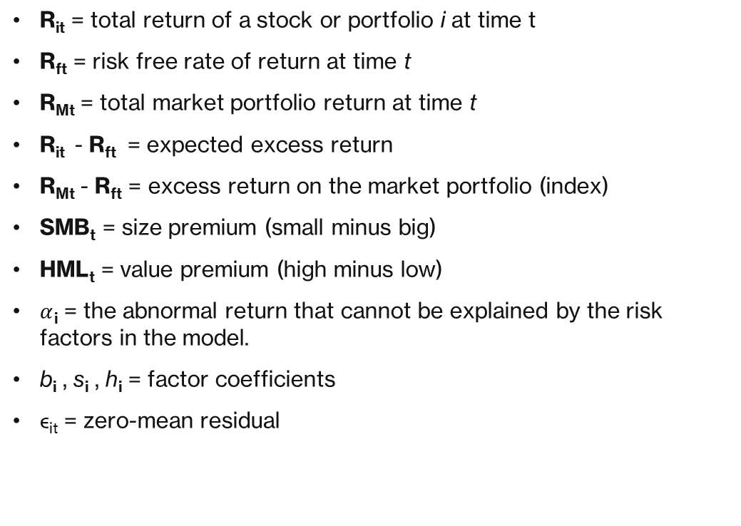
Formula
R_{it} = total return of a stock or portfolio i at time t
R_{ft} = risk free rate of return at time t
R_{Mt} = total market portfolio return at time t
R_{it} - R_{ft} = expected excess return
R_{Mt} - R_{ft} = excess return on the market portfolio (index)
SMB_{t} = size premium (small minus big)
HML_{t} = value premium (high minus low)
$α$_{i} = the abnormal return that cannot be explained by the risk factors in the model.
b_{i} , s_{i} , h_{i} = factor coefficients​
ϵ_{it}​ = zero-mean residual

Slide 9
FAMA-FRENCH
(FIVE FACTORS)
IDEA
Three factors miss much of the variation in average returns related to profitability and investment
FACTORS
The size of firms => small minus big (SMB)
Book-to-market values => high minus low (HML)
Excess return on the market => the portfolio's return minus the risk-free rate of return
Profitability => Robust Minus Weak - RMW
Investment => Conservative Minus Aggressive - CMA

Slide 10
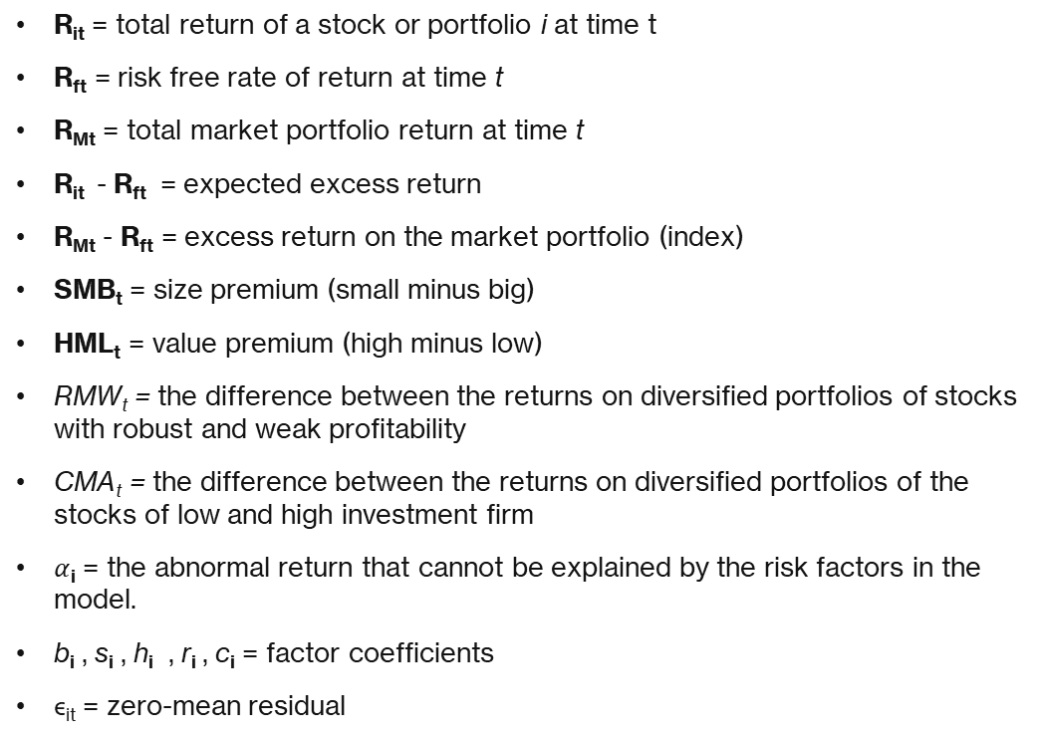
Formula
R_{it} = total return of a stock or portfolio i at time t
R_{ft} = risk free rate of return at time t
R_{Mt} = total market portfolio return at time t
R_{it} - R_{ft} = expected excess return
R_{Mt} - R_{ft} = excess return on the market portfolio (index)
SMB_{t} = size premium (small minus big)
HML_{t} = value premium (high minus low)
RMW_{t} = the difference between the returns on diversified portfolios of stocks with robust and weak profitability
CMA_{t} = the difference between the returns on diversified portfolios of the stocks of low and high investment firm
$α$_{i} = the abnormal return that cannot be explained by the risk factors in the model.
b_{i} , s_{i} , h_{i} , r_{i} , c_{i} = factor coefficients​
ϵ_{it}​ = zero-mean residual

Slide 11
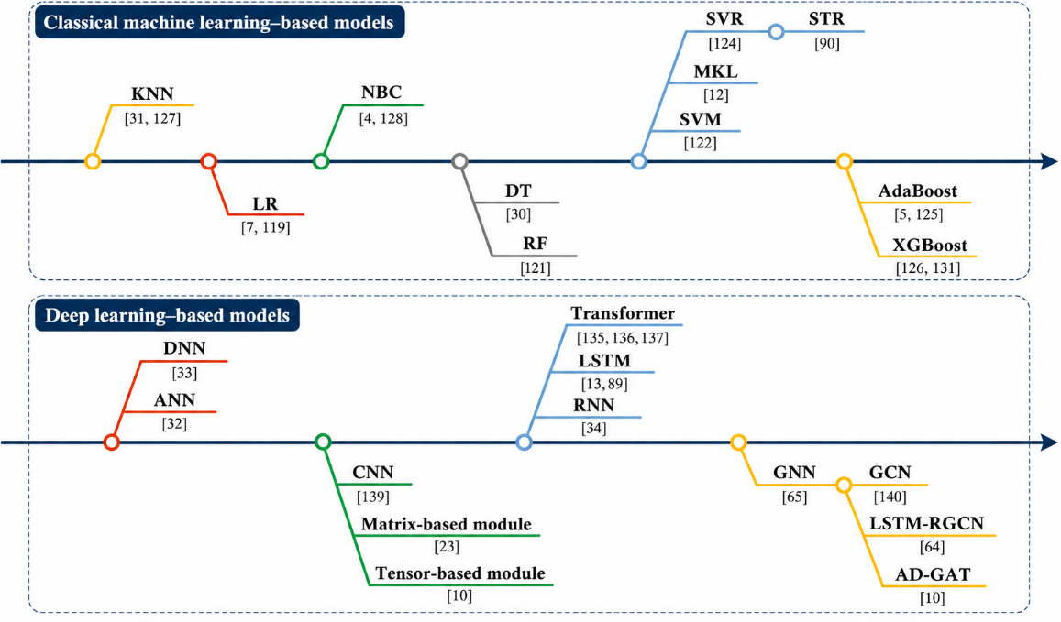
MACHINE LEARNING MODELS
Roadmap of machine learning – based models in the stock prediction

Slide 12
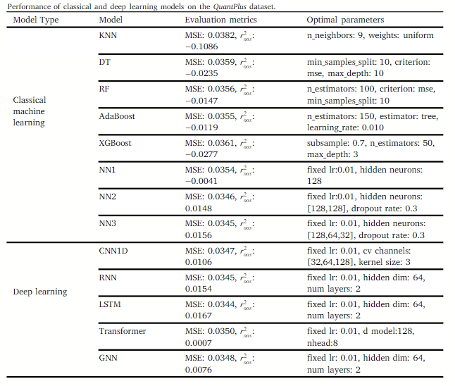
Comparison
Dataset: http://quantplus.zxlearn.cn/Factor

Slide 13
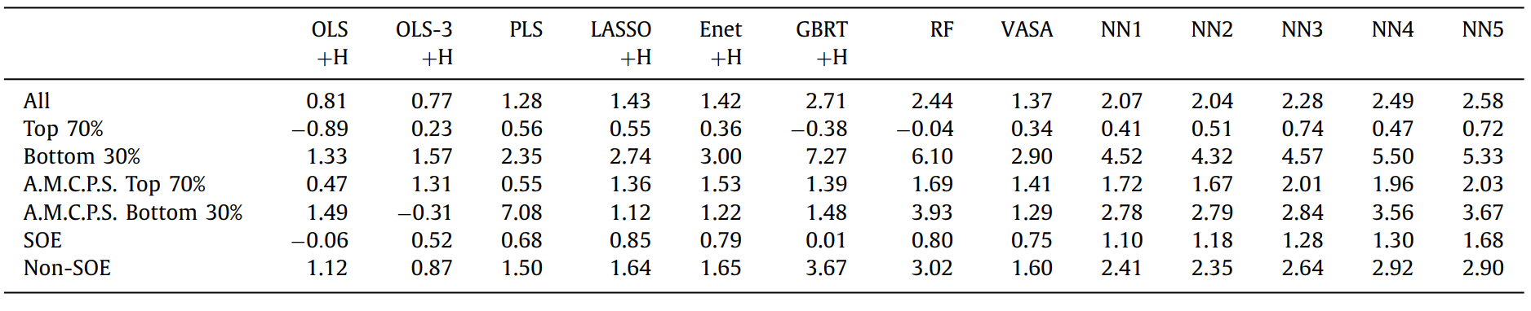
Comparison
Chinese stocks

Slide 14
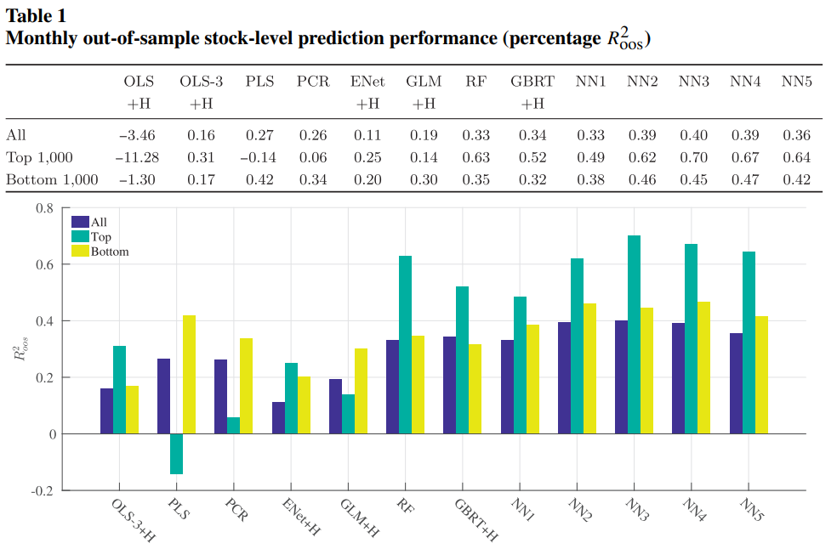
Comparison
US stocks

